Slide 1
An introduction to
TOGAF
(The Open Group Architecture Framework)

Slide 2
Part 1 :
TOGAF Basics & History

Slide 3
Who is in charge of TOGAF?
The Open Group Architecture Forum
  Architecture Framework (TOGAF)
  Architecture Tools
  Certification
TOGAF is freely available for internal use of organizations
Spring 2006
Introducong TOGAF 8.1

Slide 4
TOGAF version history
TOGAF 7 (“Technical Edition ”) , published in December 2001
TOGAF 8 (“Enterprise Edition”) , first published in December 2002 and republished in updated form as TOGAF 8.1 in December 2003
TOGAF 9 : work on it still in progress
Spring 2006
Introducong TOGAF 8.1

Slide 5
Main Difference with other frameworks
Other Frameworks list deliverables but do not say ‘how’
TOGAF answers the ‘how’ (with its ADM)
TOGAF can be used in companion with other frameworks to deliver their deliverables
TOGAF is a framework by itself, it can be used by its own to prepare its own deliverables , too!
Spring 2006
Introducong TOGAF 8.1

Slide 6
What architecture domains does TOGAF cover?
TOGAF 8.1 :
  Technology Architecture
  Application Architecture
  Data Architecture
  Business Architecture
TOGAF 7 only covered Technology Architecture
In this presentation , from now on , by ‘TOGAF’ I mean ‘TOGAF 8.1’
Spring 2006
Introducong TOGAF 8.1

Slide 7
TOGAF components
ADM
Enterprise Continuum
Resource Base
Spring 2006
Introducong TOGAF 8.1

Slide 8
Part 2:
TOGAF Components

Slide 9
Part 2 - a
ADM
(Architecture Development Method)

Slide 10
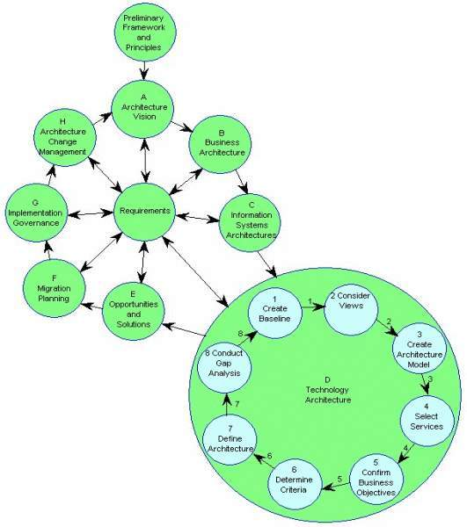
ADM (Architecture Development Method)
Spring 2006
Introducong TOGAF 8.1

Slide 11
Key points about ADM
ADM might need adoption due to :
  The enterprise ‘s circumstances
  To be integrated with another framework
ADM is iterative, over the whole process, between phases, and within phases.
For each iteration of ADM decide about:
  The scope
  What needs to be leveraged in the organization's Enterprise Continuum
Spring 2006
Introducong TOGAF 8.1

Slide 12
About scoping
It has to be done for every architectural activity
We have to scope because of limitations in time, human resource and finance
Scoping dimensions:
  Horizontal scope (enterprise scope)
  Architecture domains
  Vertical scope (level of detail)
Scoping decision made must create value to the enterprise
Spring 2006
Introducong TOGAF 8.1

Slide 13
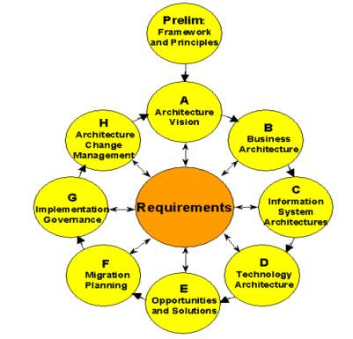
ADM Phases
A-H phases
For each phase, TOGAF 8.1 has defined :
  Objectives
  Approach
  Inputs
  Steps
  Outputs
Spring 2006
Introducong TOGAF 8.1

Slide 14
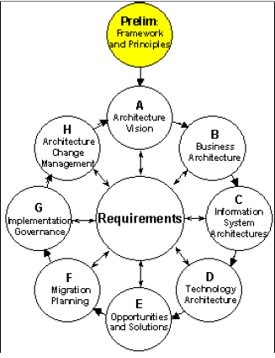
ADM preliminary phase
Make sure all who should be involved are committed
Define architecture principles and assumptions
List the people performing it and their locations and responsibilities
Define framework and methodology
Define procedures for evaluation
Spring 2006
Introducong TOGAF 8.1

Slide 15
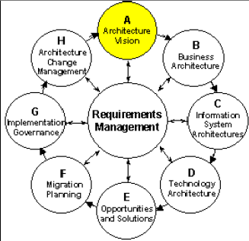
ADM Phase A: Architecture Vision
validate the business principles, business goals, and strategic business drivers of the organization
define the scope of, and to identify and prioritize the components of the current architecture effort
define the relevant stakeholders, and their concerns and objectives.
define the key business requirements to be addressed in this architecture effort, and the constraints that must be dealt with
secure formal approval to proceed.
Spring 2006
Introducong TOGAF 8.1

Slide 16
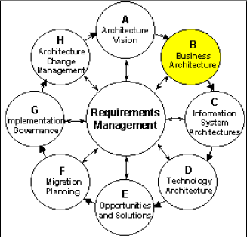
ADM Phase B : Business Architecture
describe the current baseline business architecture (using modeling tools such as UML)
develop a target Business Architecture, describing the product and/or service strategy, and the organizational, functional, process, information, and geographic aspects of the business environment, based on the business principles, business goals, and strategic drivers.
analyze the gaps between the baseline and target Business Architectures
Spring 2006
Introducong TOGAF 8.1

Slide 17
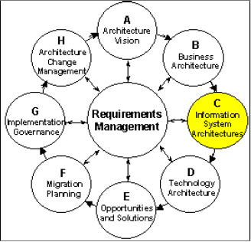
ADM Phase C :Information System Architecture
develop target architectures covering either or both (depending on project scope) of the Data and Application Systems domains.
Data: define the major types and sources of data necessary to support the business – define data entities – no database design
Applications: define the major kinds of application system necessary to process the data and support the business – described as logical groups of capabilities– without reference to particular technologies – stable and relatively unchanging over time, whereas the technology used to implement them will change over time
Spring 2006
Introducong TOGAF 8.1

Slide 18
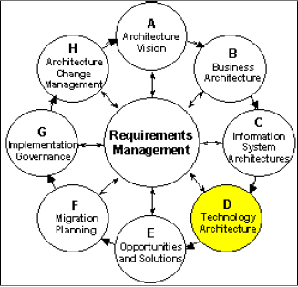
ADM Phase D : Technology Architecture
develop a technology architecture that will form the basis of the following implementation work
As part of this Phase, the architecture team will need to consider what relevant technology architecture resources are available in the Architecture Continuum like TOGAF Technical Reference Model (TRM)
Spring 2006
Introducong TOGAF 8.1

Slide 19
More on Technology Architecture
Guides procurement process
Service bundles are represented in a Technology Architecture in the form of "Building Blocks".
The IT architect must analyze the services actually needed in order to implement an IT infrastructure that meets the enterprise's business requirements in the optimal manner, and define the set of optimal solution building blocks - real-world "platforms" - to implement that architecture.
One of the key tasks of the IT architect in going from the conceptual Application Platform of the TRM to an enterprise-specific Technology Architecture, is to look beyond the set of real-world "platforms" already in existence in the enterprise.
Spring 2006
Introducong TOGAF 8.1

Slide 20
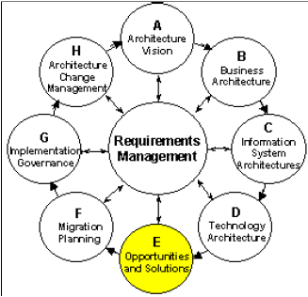
ADM Phase E : Opportunities and Solutions
evaluate and select among the implementation options identified in the development of the various target architectures (for example, build vs. buy vs. reuse options)
identify the strategic parameters for change, and the top-level work packages or projects to be undertaken in moving from the current environment to the target
generate an overall implementation and migration strategy
Spring 2006
Introducong TOGAF 8.1

Slide 21
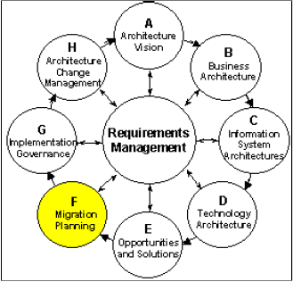
ADM Phase F : Migration Planning
to sort the various implementation projects into priority order
Generate a detailed implementation plan
Spring 2006
Introducong TOGAF 8.1

Slide 22
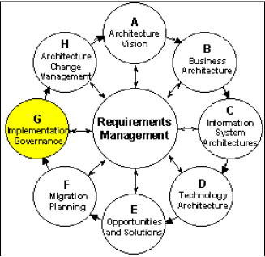
ADM Phase G : Implementation Governance
formulate recommendations for each implementation project
perform appropriate governance functions while the system is being implemented and deployed
ensure conformance with the defined architecture
Spring 2006
Introducong TOGAF 8.1

Slide 23
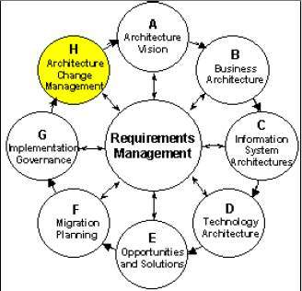
ADM Phase H : Architecture Change Management
provide for the continual monitoring of such things as new developments in technology and changes in the business environment, and for determining whether to formally initiate a new architecture evolution cycle
Spring 2006
Introducong TOGAF 8.1

Slide 24
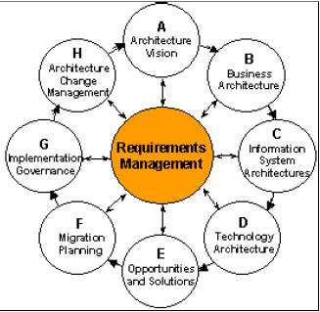
ADM Architecture Requirements Management
not a static set of requirements, but a dynamic process whereby requirements for enterprise architecture and subsequent changes to those requirements are identified, stored, and fed into and out of the relevant ADM phases.
Changes such as changing market conditions, new legislation, etc.
Spring 2006
Introducong TOGAF 8.1

Slide 25
Part 2 - b
Enterprise Continuum

Slide 26
Enterprise Continuum
A repository of reusable building blocks
ADM both uses (ready building blocks) from and adds (organization-specific building blocks) to it
Contains :
  Work in progress
  Previous work done in this organization
  Reference models and patterns
Sample content:
  In the development of a Technology Architecture, this may be TOGAF's own Foundation Architecture.
  In the development of a business architecture, it may be a reference model for e-Commerce taken from the industry at large.
Spring 2006
Introducong TOGAF 8.1

Slide 27
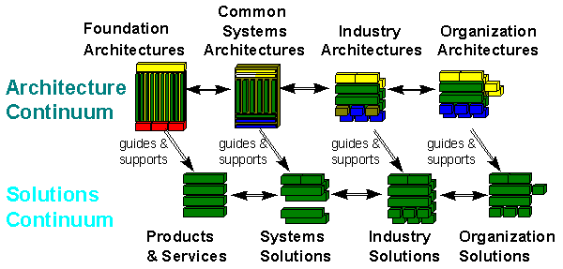
Enterprise Continuum
Read details about the components in this picture, here.
Spring 2006
Introducong TOGAF 8.1

Slide 28
Enterprise Continuum
specifies a progression for developing architectures and solutions using architecture building blocks and solution building blocks in a continuous, iterative fashion.
A building block is simply a grouping of functionality defined to meet business needs. An architecture building block is described with a general level of detail. Solution building blocks reflect real products or specific custom developments.
The TOGAF ADM guides you through the left-to-right progression from the general architectures and solutions (on the left), to organization-specific ones (on the right).
The relationship between the Architecture Continuum and the Solutions Continuum is one of guidance, direction, and support. You build an architecture by navigating the two continuums, from left to right, top to bottom, so that you are specifying architecture building blocks at each stage, and then the solution building blocks that implement them, and continuing rightward, building upon the solution and adding increasing detail.
Spring 2006
Introducong TOGAF 8.1

Slide 29
About the Enterprise Continuum components
A Foundation Architecture consists of architecture building blocks and corresponding standards that support a complete computing environment. TOGAF's pre-supplied Foundation Architecture consists of the Technical Reference Model and Standards Information Base.
A Common System Architecture is complete in terms of a particular problem domain, but incomplete in terms of the overall information system functionality. Examples of Common Systems Architectures are a Network Architecture, or a Security Architecture. A System Solution is an implementation of a Common System Architecture comprising a set of products and services.
Industry Architectures include pre-built, off-the-shelf architectures that have been developed for particular vertical industries. These often include pre-built data models and business processes. An Industry Solution is an implementation of an Industry Architecture.
Spring 2006
Introducong TOGAF 8.1

Slide 30
Reference Models
Used in conjunction with ADM
Each reference model consists of :
  Taxonomy : defines terminology, and provides a coherent description of the components and conceptual structure of the model
  Graphic : provides a visual representation of the taxonomy, and the inter-relationship of the components, as an aid to understanding.
Spring 2006
Introducong TOGAF 8.1

Slide 31
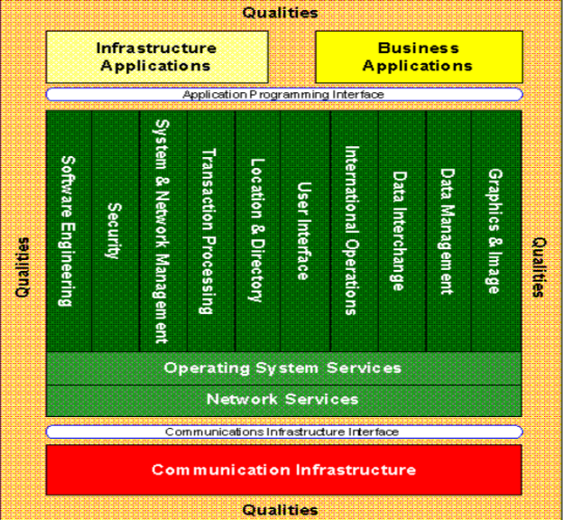
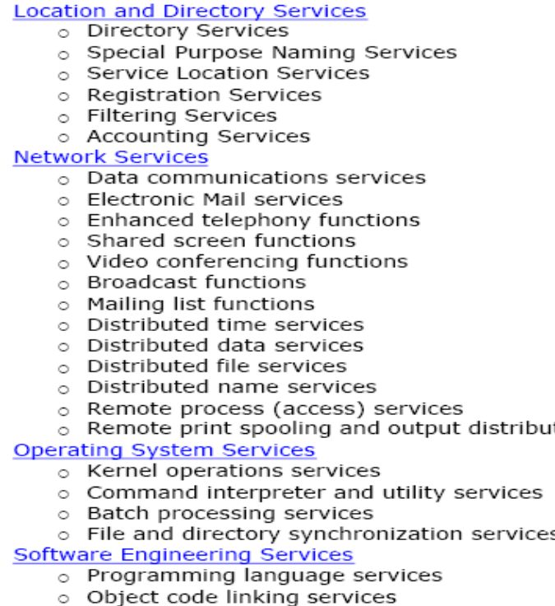
TRM
graphic
TRM
taxonomy
Foundation architecture
Standards Information Base (SIB)
Spring 2006
Introducong TOGAF 8.1

Slide 32
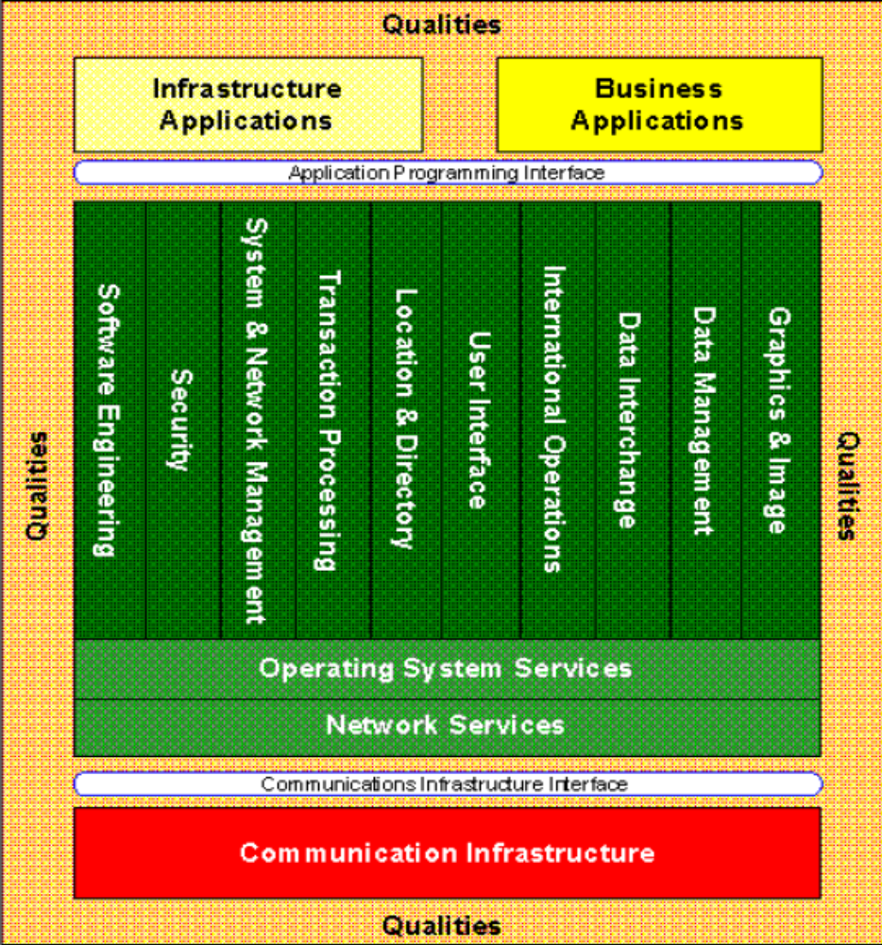
TRM - Graphic
Application Platform
Spring 2006
Introducong TOGAF 8.1

Slide 33
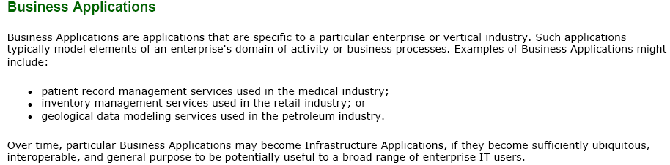
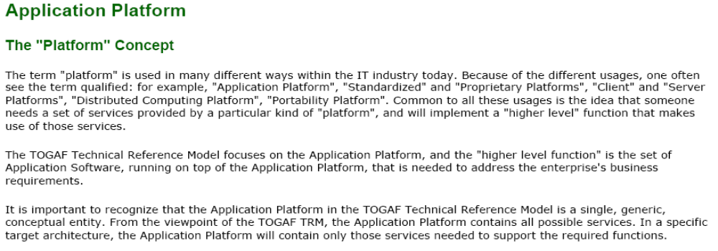
TRM – Taxonomy - Definitions
Spring 2006
Introducong TOGAF 8.1

Slide 34
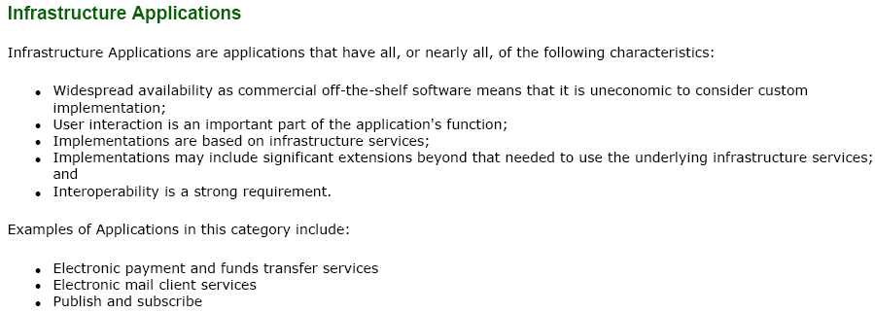
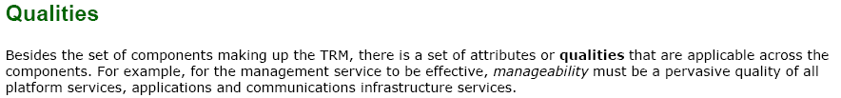
TRM – Taxonomy - Definitions
Spring 2006
Introducong TOGAF 8.1

Slide 35
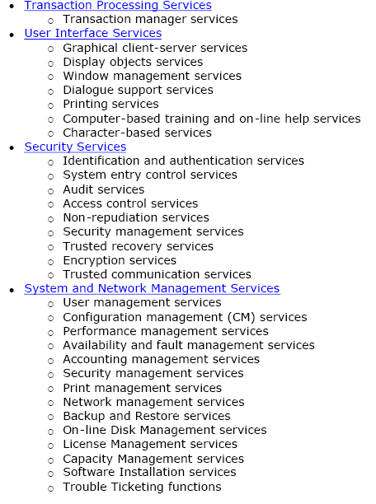
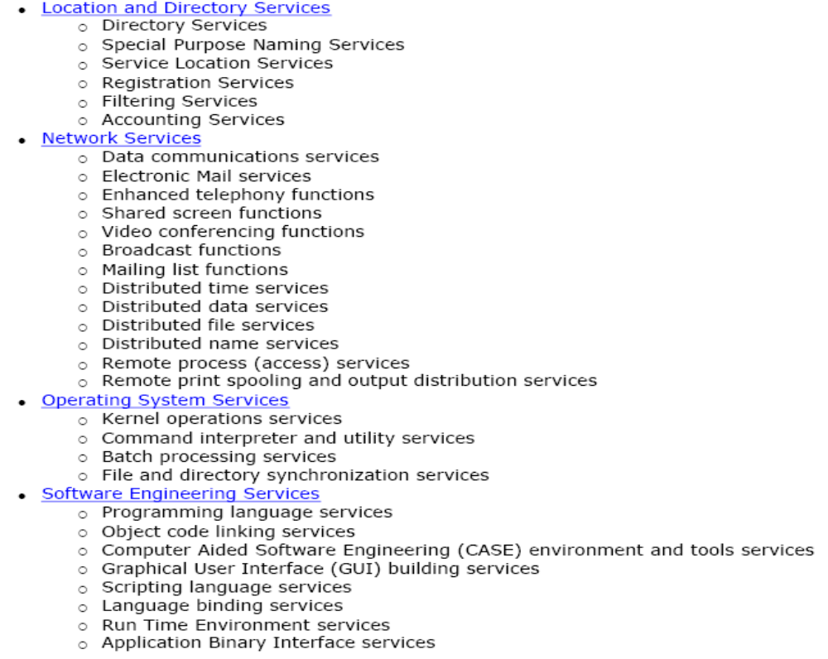
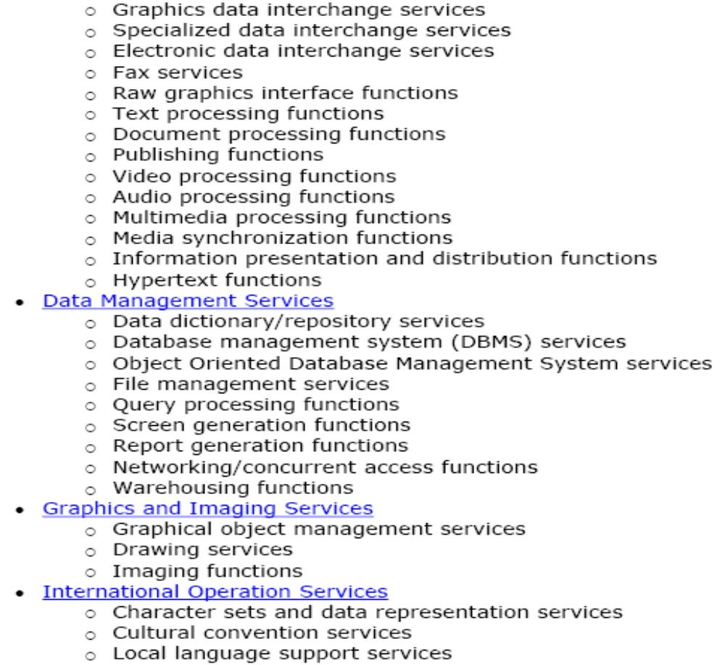
Application Platform
Service Categories:
Spring 2006
Introducong TOGAF 8.1

Slide 36
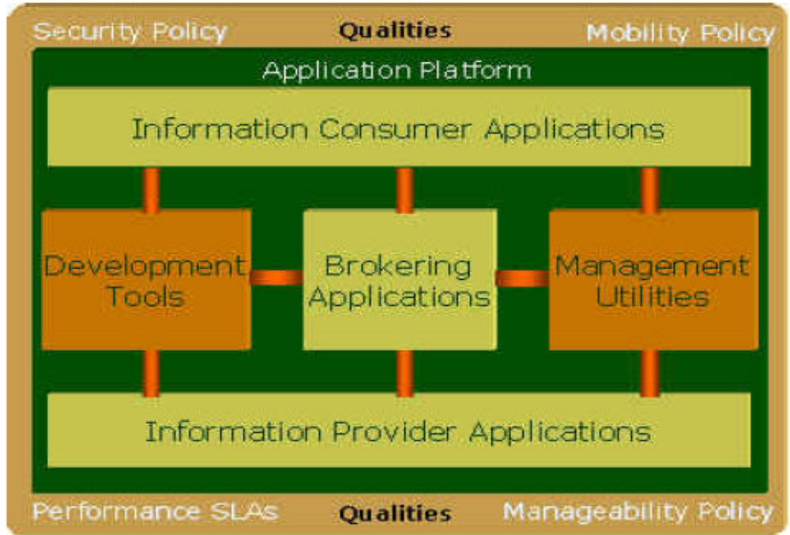
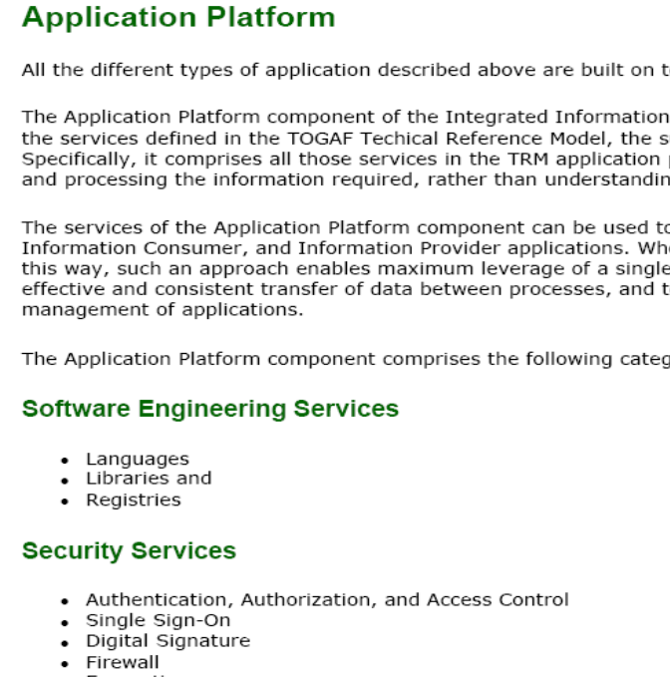
IIIRM
graphic
IIIRM
taxonomy
Common System Architecture
Standards Information Base (SIB)
Spring 2006
Introducong TOGAF 8.1

Slide 37
Why IIIRM? (What problem does it address?)
Goal :
  getting information to the right people at the right time in a secure, reliable manner in support of core organization operations
Goal prerequisite:
  Get over limitations imposed by traditional organization structures.
Solution :
  cross-functional teams
Solution prerequisite:
  provide access to information to each cross-functional team on an as-required basis, and yet the sources of this data can be numerous and the volumes huge.
Obstacle:
  the IT systems were built for each functional department (do not allow for information to flow in support of the boundaryless organization)
Approach:
  Integrated Information Infrastructure
    integrated information
    integrated access to that information
Spring 2006
Introducong TOGAF 8.1

Slide 38
Why IIIRM? (What problem does it address?)
Goal :
  getting information to the right people at the right time in a secure, reliable manner in support of core organization operations
Goal prerequisite:
  Get over limitations imposed by traditional organization structures.
Solution :
  cross-functional teams
Solution prerequisite:
  provide access to information to each cross-functional team on an as-required basis, and yet the sources of this data can be numerous and the volumes huge.
Obstacle:
  the IT systems were built for each functional department (do not allow for information to flow in support of the boundaryless organization)
Approach:
  Integrated Information Infrastructure
    integrated information
    integrated access to that information
The Open Group published IIIRM, which depicts the major components required to address the Boundaryless Information Flow problem space, and can help the architect in this task.
Spring 2006
Introducong TOGAF 8.1

Slide 39
IIIRM vs. TRM
IIIRM Consists of : application, application platform, and qualities
Shift of attention from Application Platform space in TRM to Application space in IIIRM
TRM is a "Foundation Architecture“ in the Enterprise Continuum. IIIRM is a "Common Systems Architecture" .
IIIRM is a subset of TRM in terms of its overall scope, but also extends the Applications part to enable "boundaryless information flow".
Spring 2006
Introducong TOGAF 8.1

Slide 40
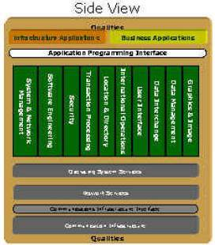
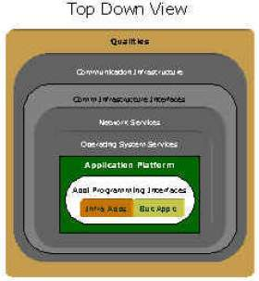
IIIRM - Graphic
Grey areas are not in IIIRM.
Spring 2006
Introducong TOGAF 8.1

Slide 41
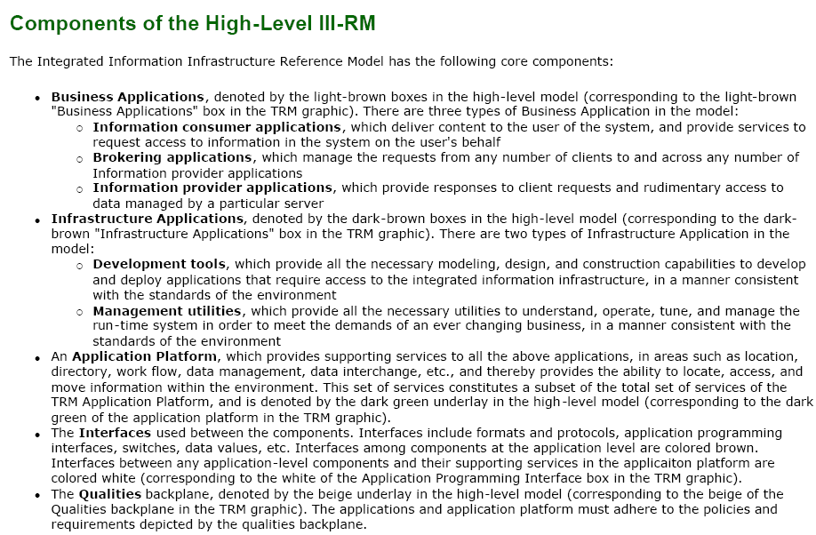
IIIRM – Taxonomy
Spring 2006
Introducong TOGAF 8.1

Slide 42
Part 2 - c
Resource Base

Slide 43
Resource Base
a set of resources - guidelines, templates, checklists, and other detailed materials supporting the TOGAF ADM
Spring 2006
Introducong TOGAF 8.1

Slide 44
A sample checklist:
Architecture Review Checklist - Information Management
Data Values
  1. What are the processes that standardize the management and use of the data?
  2. What business process supports the entry and validation of the data? Use of the data?
  3. What business actions correspond to the creation and modification of the data?
  4. What business actions correspond to the deletion of the data and is it considered part of a business record?
  5. What are the data quality requirements required by the business user?
  6. What processes are in place to support data referential integrity and / or normalization?
Spring 2006
Introducong TOGAF 8.1

Slide 45
A sample checklist : (cont ‘d)
Architecture Review Checklist - Information Management
Data Definition
  1. What are the data model, data definitions, structure, and hosting options of purchased applications (COTS)?
  2. What are the rules for defining and maintaining the data requirements and designs for all components of the
  information system?
  3. What shareable repository is used to capture the model content and the supporting information for data?
  4. What is the physical data model definition (derived from logical data models) used to design the database?
  5. What software development and data management tools been selected?
  6. What data owners have been identified to be responsible for common data definitions, eliminating unplanned
  redundancy, providing consistently reliable, timely, and accurate information, and protecting data from misuse and destruction?
Spring 2006
Introducong TOGAF 8.1

Slide 46
A sample checklist : (cont ‘d)
Architecture Review Checklist - Information Management
Security/Protection
  1. What are the data entity and attribute access rules, which protect the data from unintentional and unauthorized
  alterations, disclosure, and distribution?
  2. What are the data protection mechanisms to protect data from unauthorized external access?
  3. What are the data protection mechanisms to control access to data from external sources that temporarily have internal residence within Boeing?
Spring 2006
Introducong TOGAF 8.1

Slide 47
A sample checklist : (cont ‘d)
Architecture Review Checklist - Information Management
Hosting, Data Types, and Sharing
  1. What is the discipline for managing sole-authority data as one logical source with defined updating rules for physical data residing on different platforms?
  2. What is the discipline for managing replicated data, which is derived from operational sole-authority data?
  3. What tier data server has been identified for the storage of high- or medium-critical operational data?
  4. What tier data server has been identified for the storage of type C operational data?
  5. What tier data server has been identified for the storage of decision support data contained in a data warehouse?
  6. What database management systems have been implemented?
Spring 2006
Introducong TOGAF 8.1

Slide 48
A sample checklist : (cont ‘d)
Architecture Review Checklist - Information Management
Hosting, Data Types, and Sharing
  1. What is the discipline for managing sole-authority data as one logical source with defined updating rules for physical data residing on different platforms?
  2. What is the discipline for managing replicated data, which is derived from operational sole-authority data?
  3. What tier data server has been identified for the storage of high- or medium-critical operational data?
  4. What tier data server has been identified for the storage of type C operational data?
  5. What tier data server has been identified for the storage of decision support data contained in a data warehouse?
  6. What database management systems have been implemented?
Spring 2006
Introducong TOGAF 8.1

Slide 49
A sample checklist : (cont ‘d)
Architecture Review Checklist - Information Management
Common Services
  1. What are the standardized distributed data management services (e.g., validation, consistency checks, data edits,
  encryption, and transaction management) and where do they reside?
Access Method
  1. What are the data access requirements for standard file, message, and data management?
  2. What are the access requirements for decision support data?
  3. What are the data storage and the application logic locations?
  4. What query language is being used?
Spring 2006
Introducong TOGAF 8.1

Slide 50
A second sample checklist
Architecture Review Checklist - Security
Security Awareness
Identification / Authentication
Authorization
Access controls
Sensitive Information Protection
Audit Trails and Audit Logs
External Access Considerations
Spring 2006
Introducong TOGAF 8.1

Slide 51
Part 3 :
Last Words about TOGAF

Slide 52
TOGAF vs. Zachman Framework
Zachman Framework is a logical structure for describing any complex object like an enterprise. It is known as a de facto standard for classifying the artifacts developed in enterprise architecture.
The Open Group's vision for TOGAF is as a vehicle and repository for practical, experience-based information on how to go about the process of enterprise architecture, providing a generic method with which specific sets of deliverables, specific reference models, and other relevant architectural assets, can be integrated.
Spring 2006
Introducong TOGAF 8.1

Slide 53
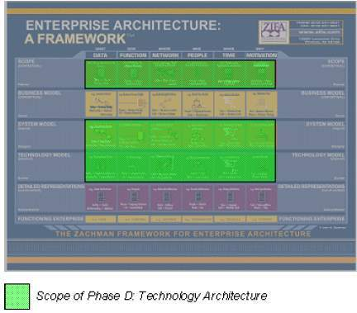
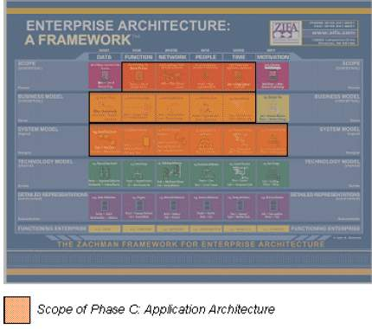
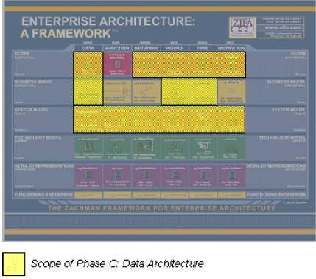
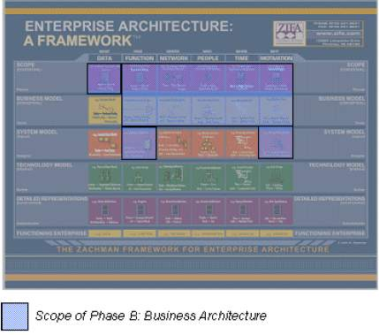
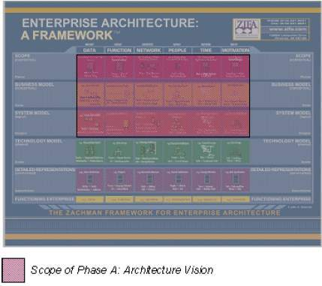
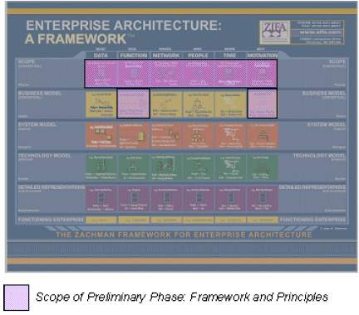
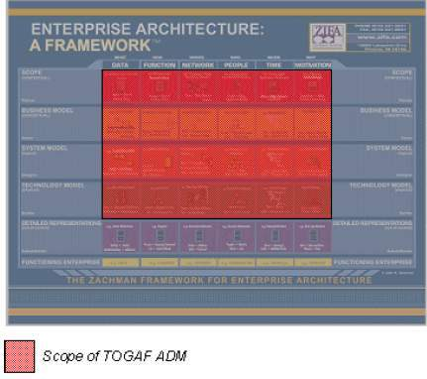
Mapping the TOGAF ADM to Zachman Framework
Spring 2006
Introducong TOGAF 8.1

Slide 54
Putting it Altogether :
What does TOGAF provide for IT Architects?
TOGAF
How to do it?
ADM
?
Templates
to start with
Reference models
Building blocks
and reuse guide
Enterprise
Continuum
Spring 2006
Introducong TOGAF 8.1

Slide 55
References
Open Group TOGAF homepage
IBM whitepapers:
  Introducing The Open Group Architecture Framework (TOGAF)
  Understand The Open Group Architecture Framework (TOGAF) and IT architecture in today's world
Developers.com
Wikipedia
Spring 2006
Introducong TOGAF 8.1

